Slide 1
A Better Alternative
The Medical Benefits of Marijuana
By: Chloe Maki

Slide 2
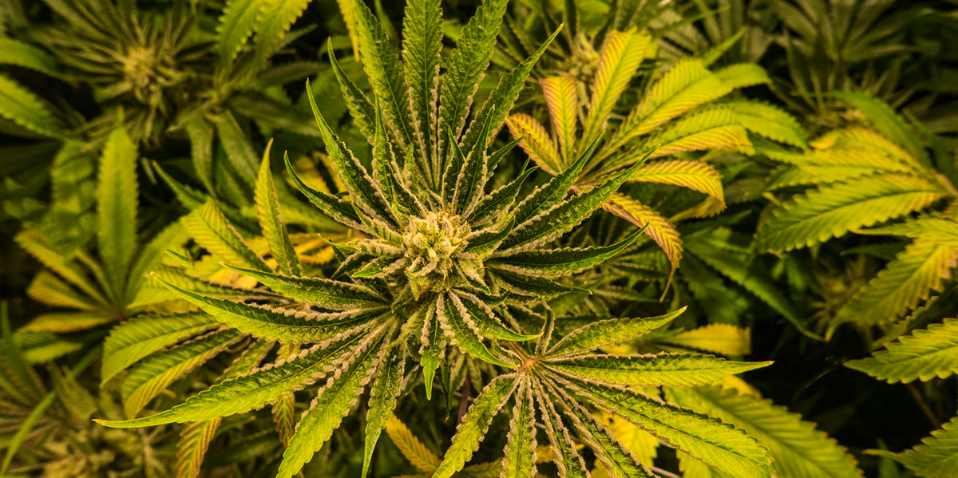
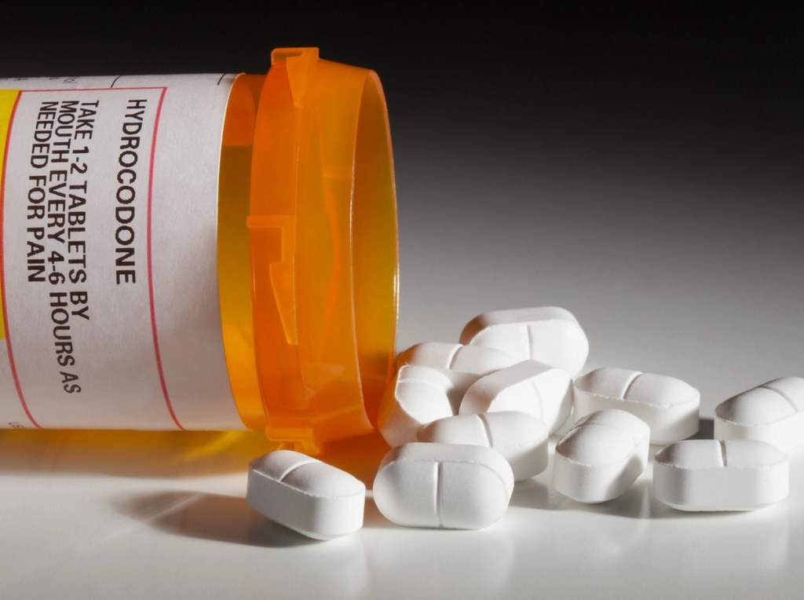
Opioids and Marijuana
“Every day, more than 130 people in the United States die after overdosing on opioids”
-National Institute on Drug Abuse
Notes:
Opioids have been used forever to treat chronic pain
However they are highly addictive
According to the NIDA, a study done in 2017 estimated that 1.7 million people in the United States suffer from a substance abuse disorder caused by a prescription opioid pain reliever.
Marijuana
Marijuana has been effectively used to treat chronic pain as well as other ailments without the addictive side effects we see in other medications like opioids.

Slide 3
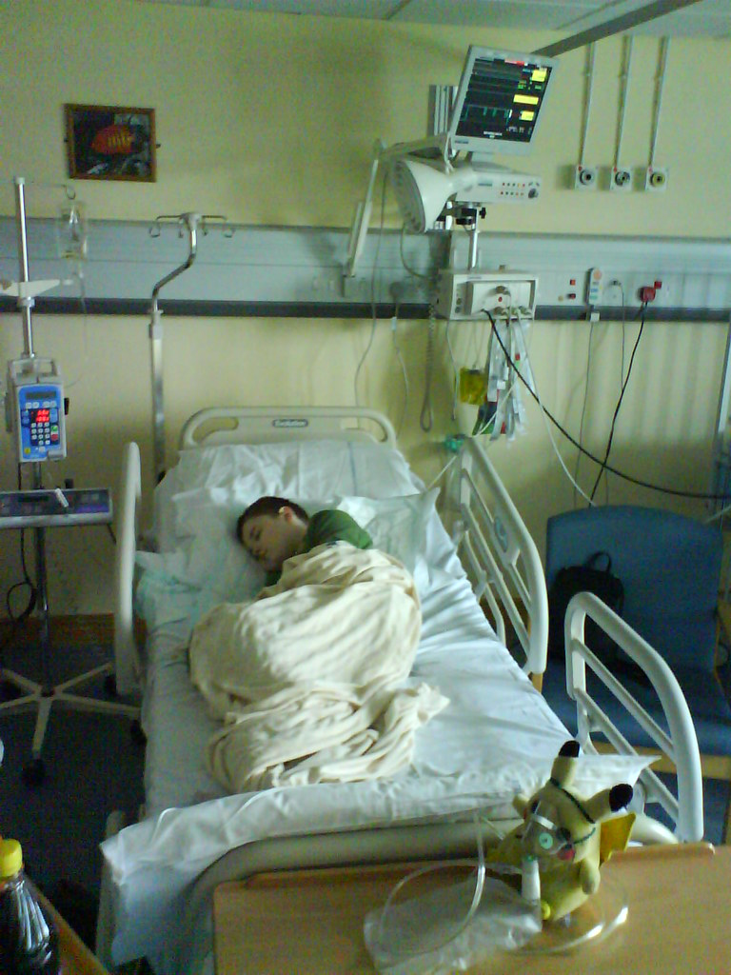
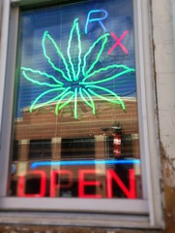

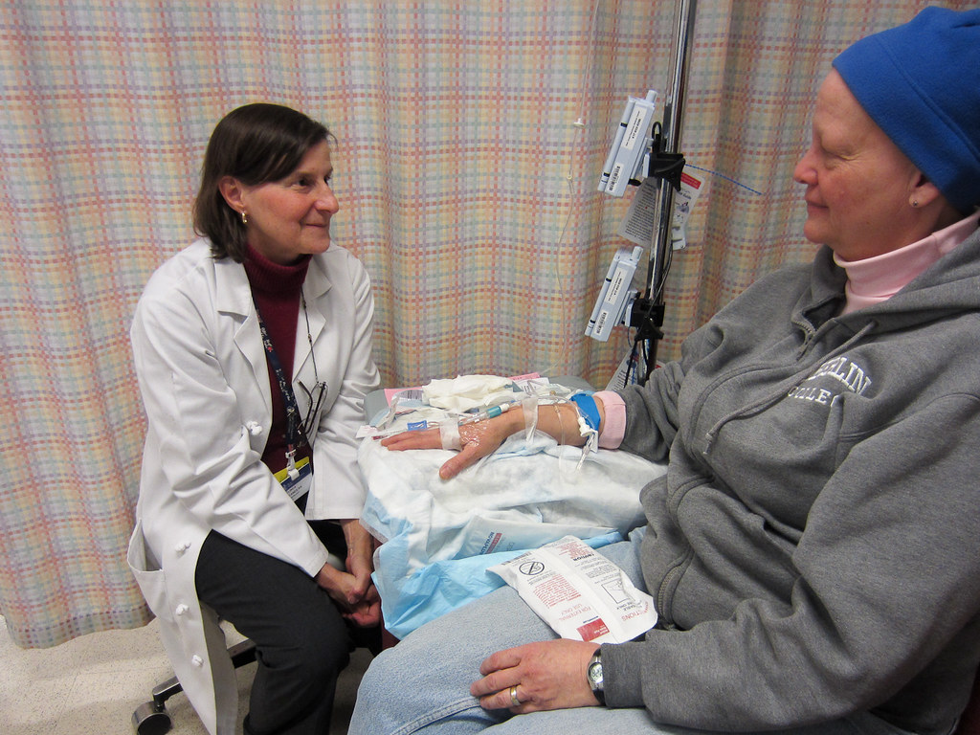
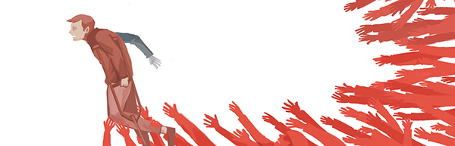
CBD
Legal
Helps with
  Inflammatory & Neuropathic Pain
  Epilepsy
THC
Illegal
Helps with
  Chemotherapy
    Extreme Nausea
  PTSD
    Nightmares
Notes:
CBD
However, unlike marijuana, CBD is legal. According to an article written by PBS, CBD is legal in the United States due to it having no psychoactive effects as well as many proven health benefits
CBD is a better alternative due to its ability to inhibit inflammatory and neuropathic pain, which are actually two of the hardest chronic pain conditions to treat.
THC
According to the National Center for Biotechnology Information (NCBI), THC has been found to eliminate extreme nausea found in patients going through chemotherapy (“Marijuana and Cancer”). Patients reported finding relief with just a low dose of THC and this can change their life, making it possible for them to eat again and gain weight as well as relieve the constant pain that they feel (“Marijuana and Cancer”).
Marijuana is currently only legal in 33 states (“Legal Medical Marijuana States”), meaning 17 states in the U.S. still see marijuana as a harmful drug.

Slide 4
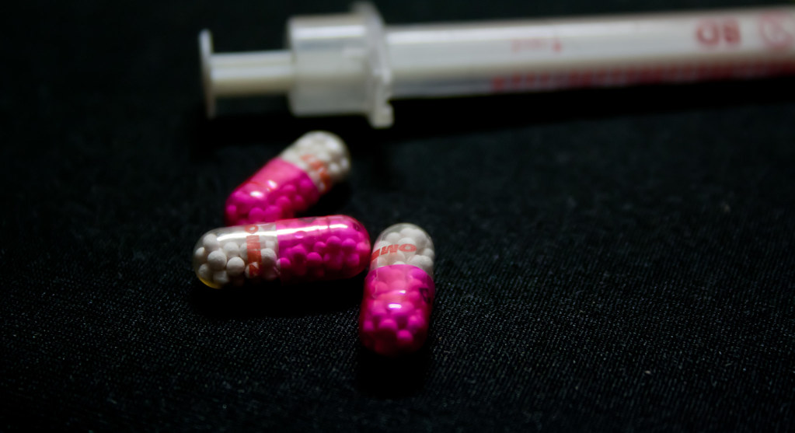
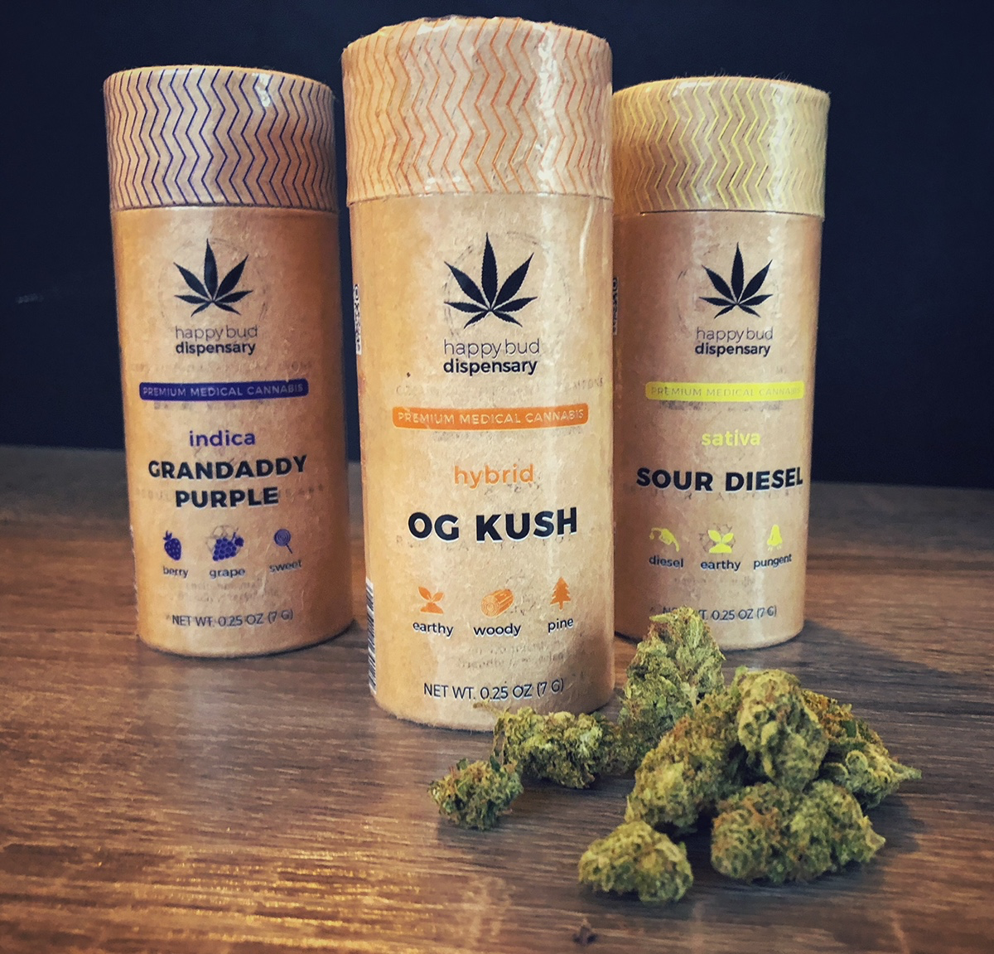
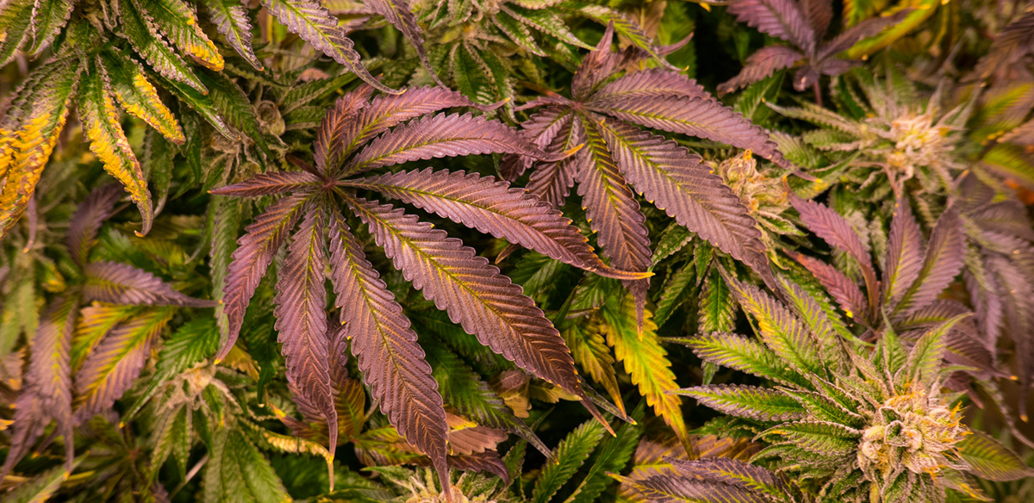
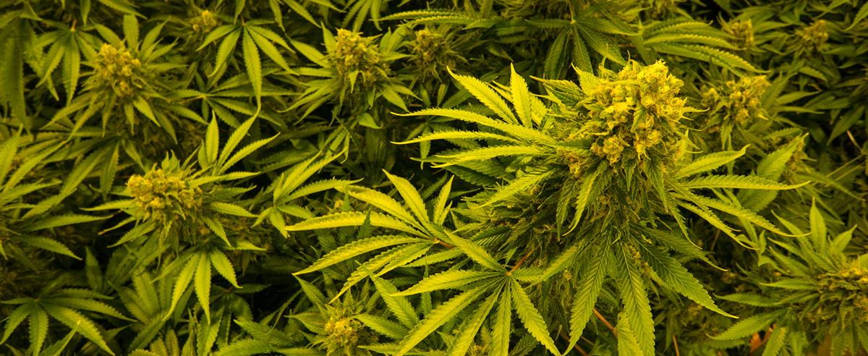
Is Marijuana Addictive?
“The presence of tolerance or dependence/withdrawal is not enough to make a diagnosis of marijuana addiction (for instance, not everyone who develops some amount of dependence to marijuana will necessarily begin to compulsively use it)” -American Addiction Center
Roughly 9% of marijuana users develop a psychological dependency
20-30% of people prescribed opioids misuse them and develop a physical dependency

Slide 5
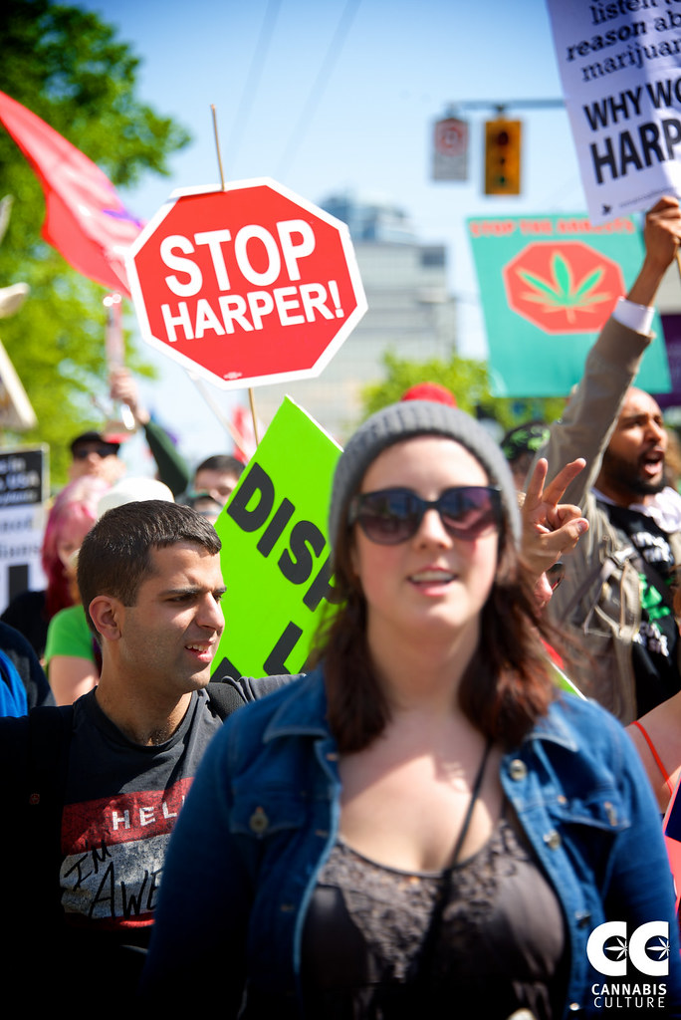
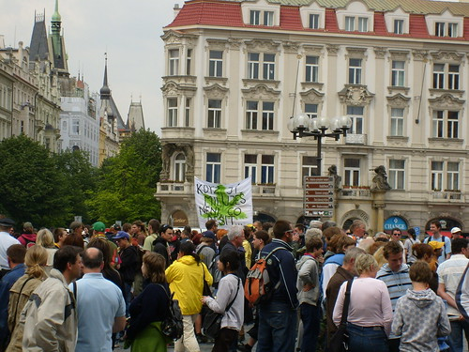
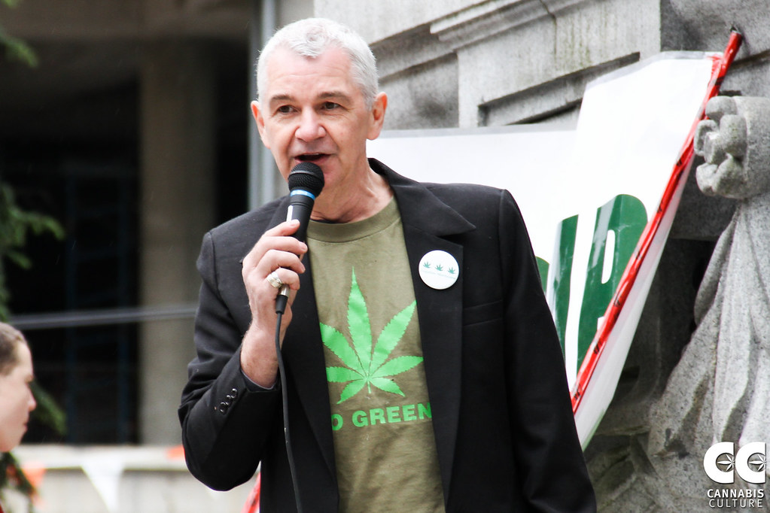
What we can do
Educate ourselves and others on the issue
Contact lawmakers and inform them that their voters are in support of the legalization of marijuana
  City hall meetings, community events, and town halls

